Slide 1


Smart Eye Drops
Sponsored by Vodafone
Marco Aguilar, Aaron Alvarez, Ana Cortes, Jonathan Nunez, Ivan Yu, Feng You
Advisor: Navid Amini, Kevin Delao
Liaison: Haley Kirk
Notes:
Hello everyone, thank you for attending the Smart Eye Drops expo today. Before we begin, I would like to play a short video from our Dean and our Director of Capstone Senior Design.
Thank you to Dr Emily Allen and Michael Thorburn for making this expo possible in these extraordinary times, and a very special "thank you" to our sponsor, Vodafone Group, for supporting our project.
My name is Feng, I am the team lead for Smart Eye Drops, and I am here today to talk about our project with my team members . . . . . . . .

Slide 2

Project Goal
To build an eye drop adherence monitor that can help reduce blindness caused by diseases such as glaucoma
Feng You
Notes:
We set out by defining what we wanted to accomplish, which was [read goals]

Slide 3
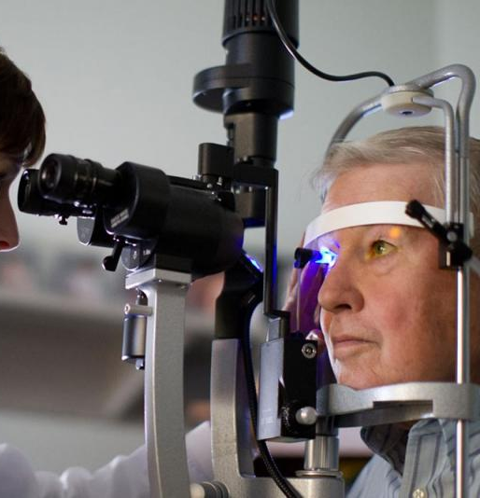
Project Significance
Glaucoma is the second leading cause of irreversible blindness worldwide
More than 3 million Americans are living with glaucoma, 2.7 million are +40 yo
Nonadherence rate for glaucoma medications range from 24 - 59%
Current ability of physicians to accurately measure adherence are poor
Feng You
Notes:
And, why are we doing this?
`
Well, glaucoma is the second leading cause of irreversible blindness worldwide
And more than 3 million Americans are living with glaucoma, 90% of whom are over the age of 40
In a study done by glaucoma specialists, that number is projected to reach more than 7 million people in 2050, growing at a rate of 28% per decade
Studies have also reported that nonadherence for glaucoma medications range from 24 – 59%
This number is given in a range because the current ability of physicians to accurately measure adherence rates are poor

Slide 4
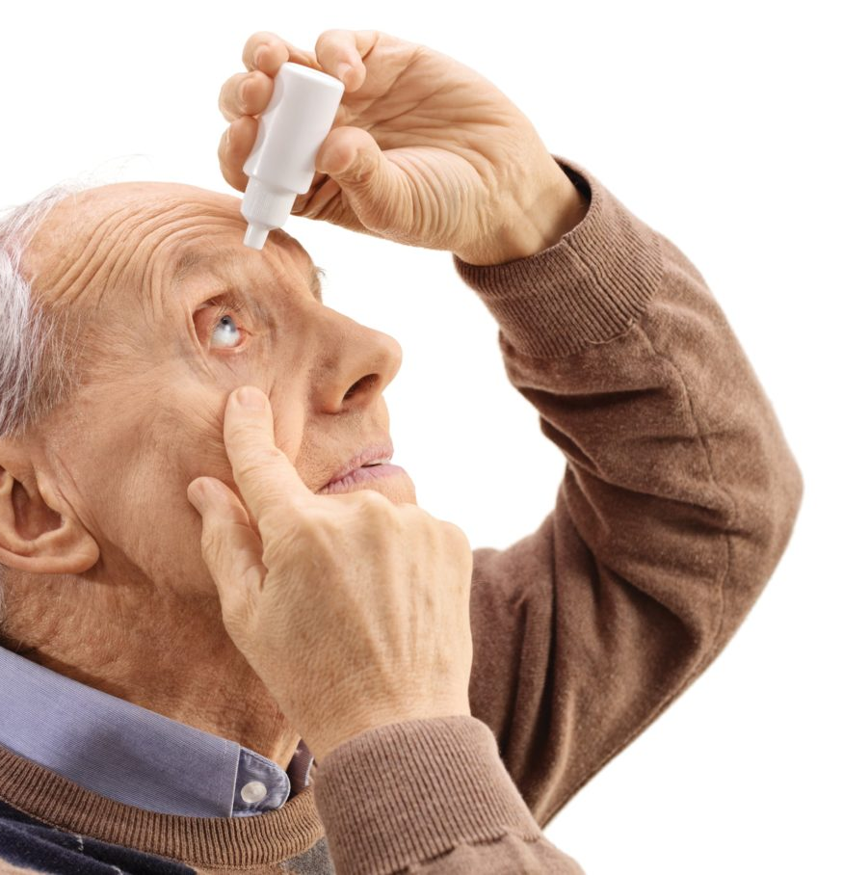
Project Significance
With Smart Eye Drops:
Physicians will be able to make personalized prescription regimens for their patients
Enable physicians to analyze whether a treatment plan is working or not
Allow physicians more control outside their office helps treatment for diseases like glaucoma
Cut back on over $2 billion in preventable costs
Feng You
Notes:
It was found that patients with glaucoma tend to stop using their medication after they feel a slight improvement. There are serious consequences that come with this but studying these side effects can be challenging if people are not taking their medication as prescribed.
`
By creating a smart eye drop bottle, we can ensure that patients abide by the instructions provided by their physicians. Using the data we collect.....
Physicians will be able to make personalized prescription regimens for their patients
Enable physicans to analyze whether a treatment plan is working or not
And allow physicians more control outside their office
`
This can allow us to cut back significantly on $2.6 billion every year in direct costs and productivity losses. According to the CDC (Center for Disease Control), every 10% improvement in adherence saves about 29% in healthcare costs. <- find something related to eyedrops

Slide 5
Project Requirements

Slide 6
Project Requirements
Develop a completely new eye drop adherence monitor
Accurately record when patients take medication
Provide valuable information to physicians to help them make better decisions on treating their patients
Feng You
Notes:
We laid out the following requirements for Smart Eye Drops:
1) First, we want to develop a completely new eye drop adherence monitoring system.
There have been other projects in the past that have tried to accomplish a similar goal, but
Might have had some issues when trying to implement all the features or requirements
Our goal is to reduce some of these obstacles while trying to build a more robust eye drop adherence application
2) Our next requirement is to accurately record when patients take their prescription, while minimizing noisy data. This is a key requirement that will ensure that the physician is not receiving the wrong information.
3) Lastly, we want to provide physicians with valuable and meaningful information to help them make better decisions on treating their patients

Slide 7
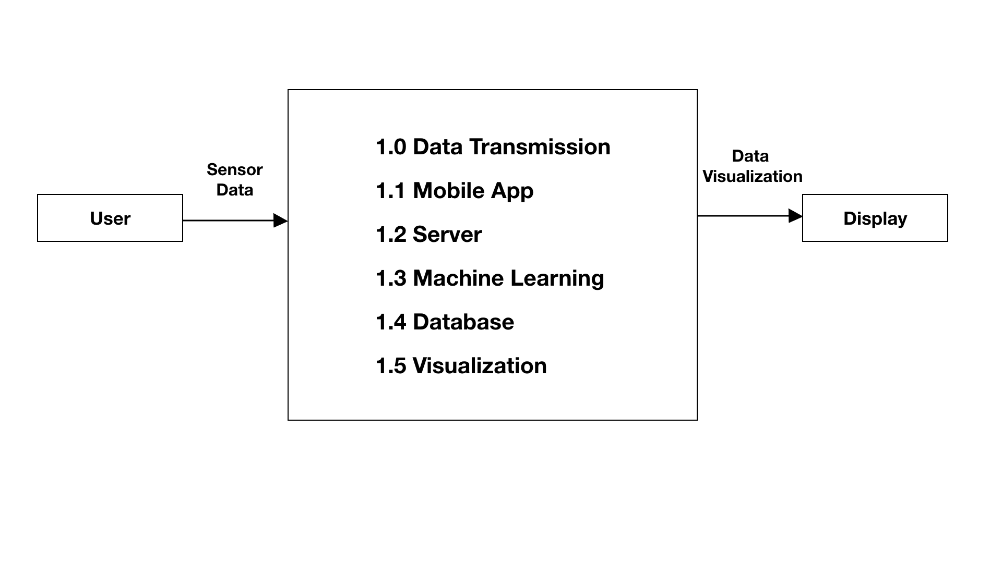
DFD 0
Feng You
Notes:
Here is a brief overview of how Smart Eye Drops works;
From left going right, the when the user of Smart Eye Drops applies their medication, raw data is collected and passed through 6 modules, and meaningful information is displayed

Slide 8
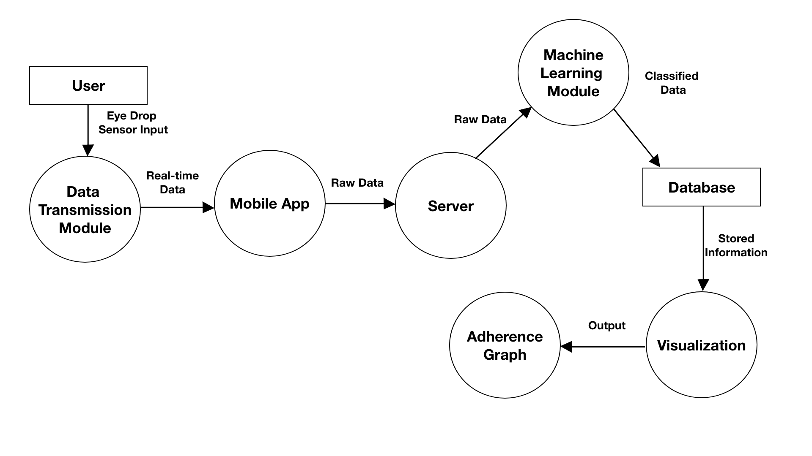
DFD 1
Feng You
Notes:
To elaborate on how each module communicates with one another;
When the user applies the eye drops, the raw data collected is passed to our data transmission module and sent in real time to our mobile app
From there, the raw data is passed onto our server, where it will forward the data to our machine learning module to be classified as "eye drop applied" or "false entry"
Then, the classified data is sent to our database to be stored
And finally, when our mobile app is opened, classified data from our data base will go through our visualization module and meaningful data will be shown on our adherence graph
DFD 1 can be a figure in the paper under methods

Slide 9
Technologies
Ana Cortes

Slide 10

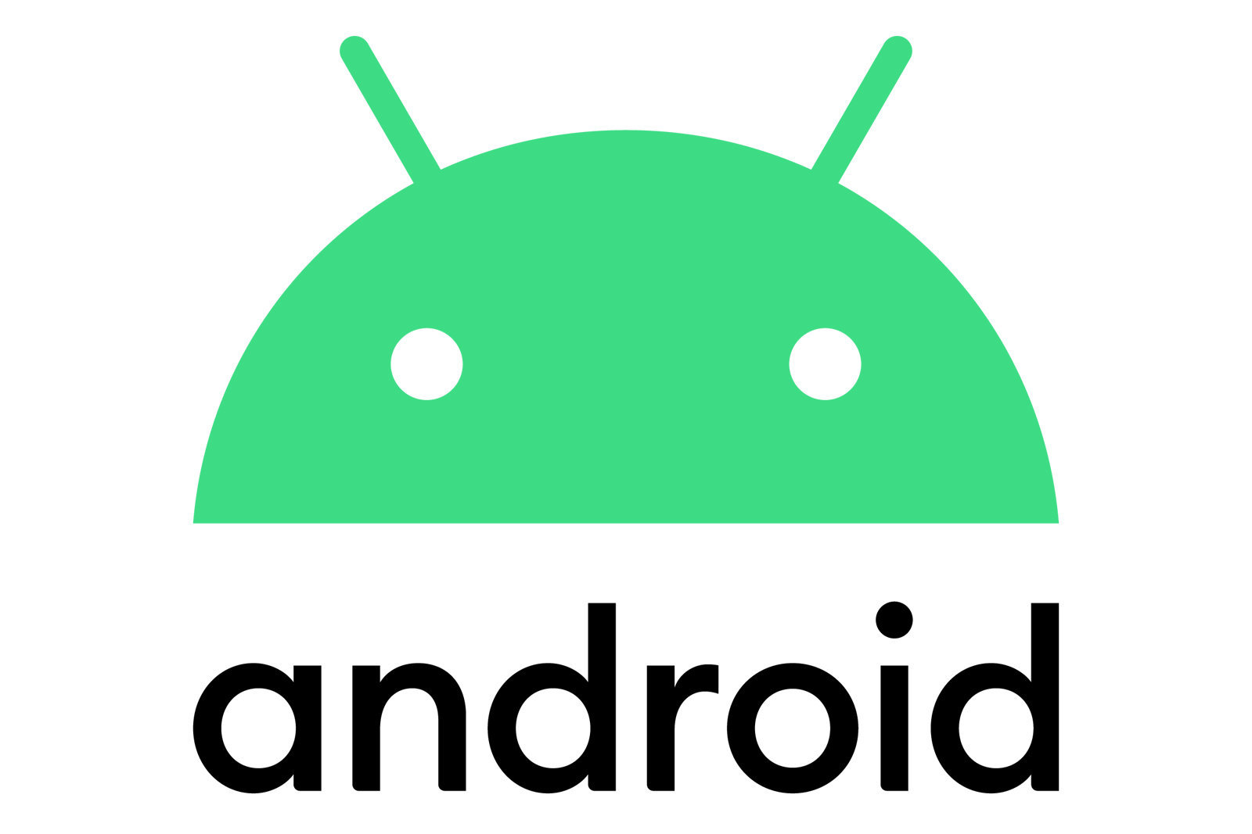

Technologies Used
MBientLab API and Technologies
Amazon Web Services (AWS)
EC2, SageMaker, DynamoDB
Android OS for mobile application
Ana Cortes
Notes:
I am going to do an overview of the technologies we used
Mbientlab is the company that provided us with our main sensor. We used Mbientlab’s api to start programming. Mbientlab already has a functional software compatible with its sensors. We used their software to get an idea as to how we could get our project running, since we used an external force sensor. We used their mobile app to help us collect data for the machine learning portion
We used many of AWS Services for Smart Eye Drops. These are a few that we used in this project. EC2 (Amazon Elastic Compute Cloud) , SageMaker, and DynamoDB
Smart Eye Drops is an android application that will be useful for medical care providers. We are using android studio and the app is written is java.

Slide 11
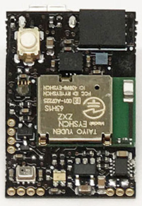
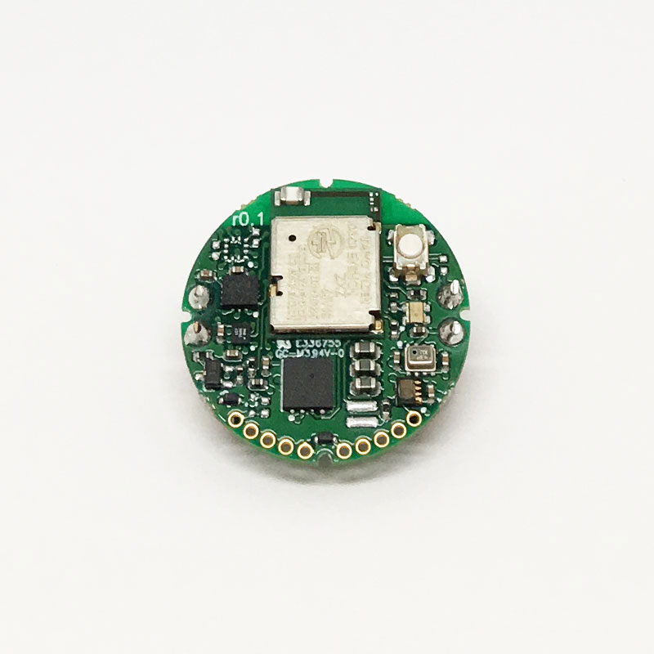
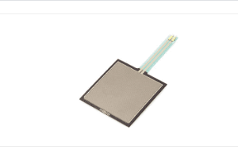
Technologies Used
MMR
MMC
MBientLab MetaMotionC (MMC) and MetaMotionR (MMR) offer real-time information of motion and environmental sensor data
Pressure sensor and MMC are attached to the eye drop container to collect input from the user and state (e.g. tilted or at equilibrium)
FSR 406
Ana Cortes
Notes:
This is what our hardware consists of. We used MbientLab’s MetaMotionC, which is a quarter sized sensor and MbientLab’s MetamotionR, which is slightly bigger and is rectangular. Although they both have many features, we focused on retrieving data from the gyroscope and accelerometer. These sensors provided us with real time sensor data. We needed a force sensor that would help detect the squeezing motion of the eye bottle. The force sensor we decided to use is the one on the bottom of the screen, the FSR model 406 from Interlink Electronics.

Slide 12
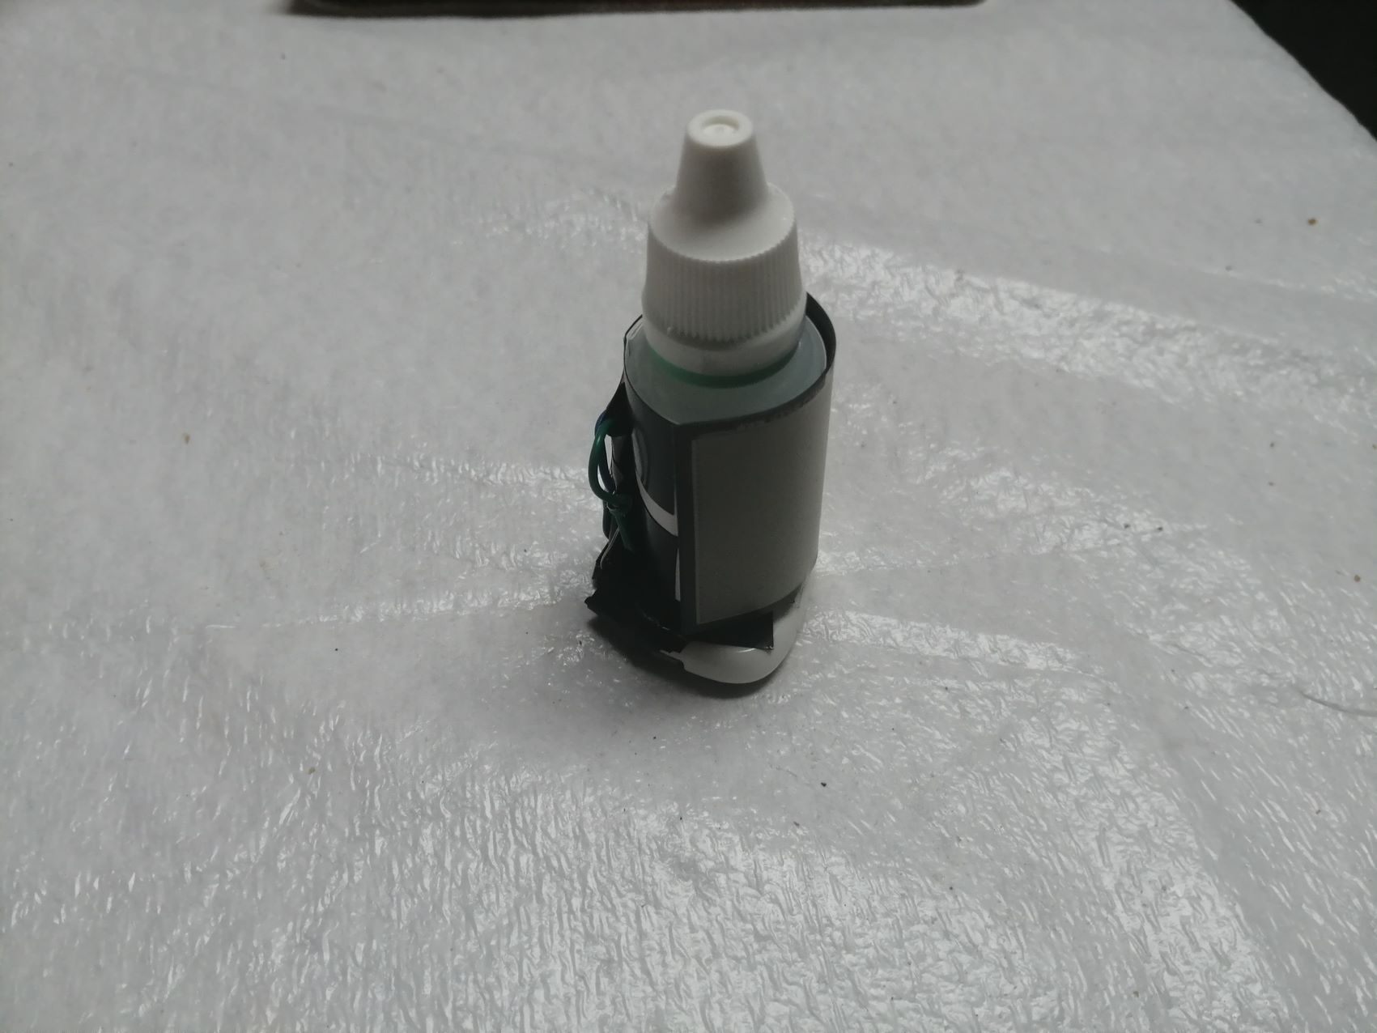
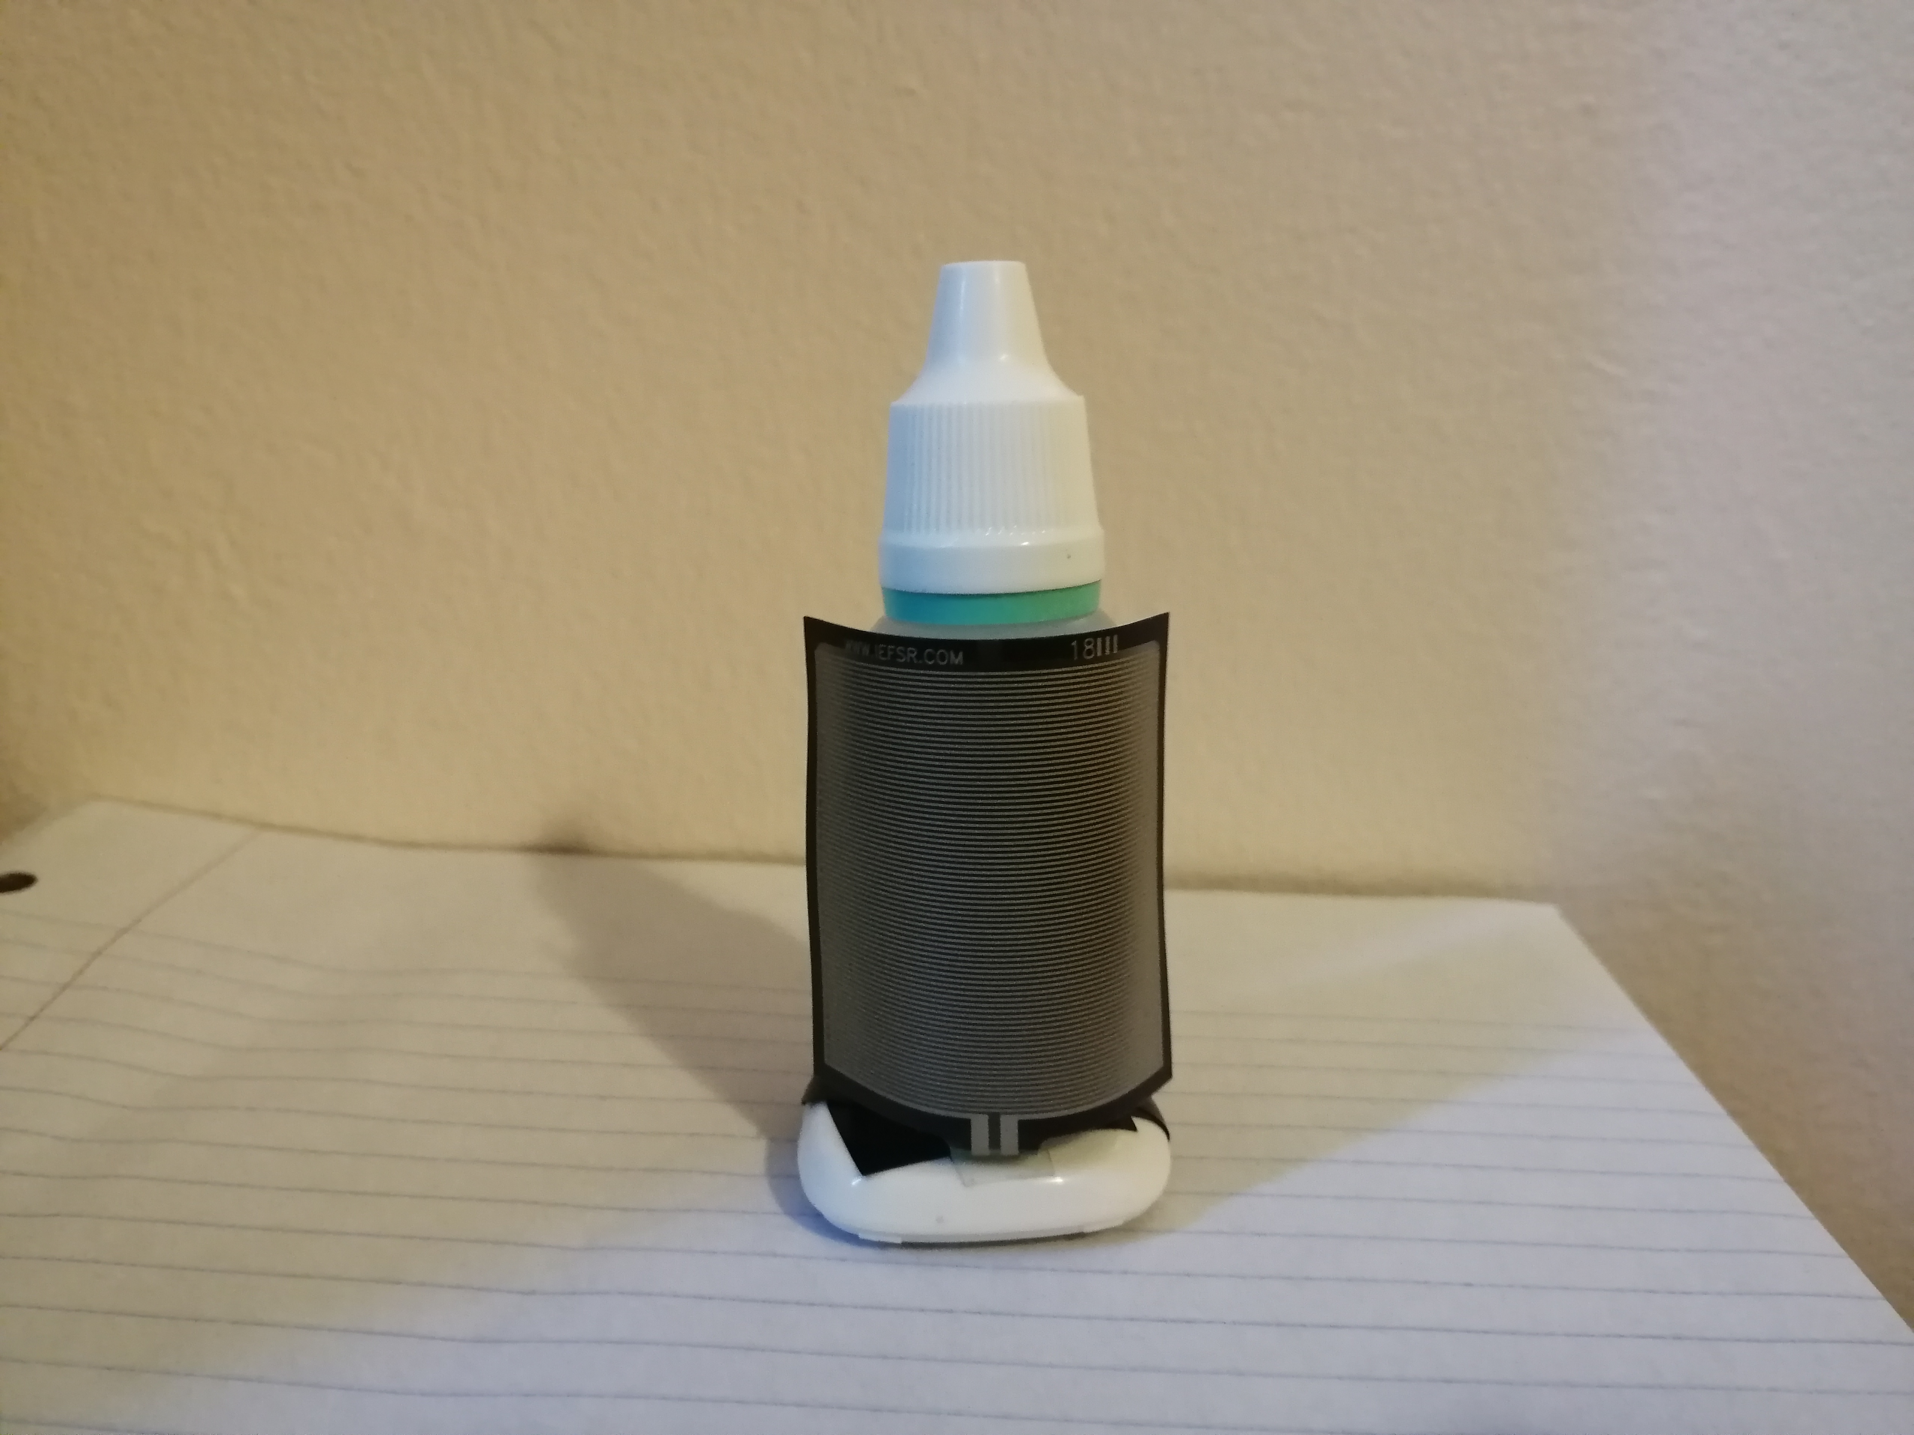
Prototype
Eye drop bottle
Force sensor
8cm
MMR Sensor
3cm
Notes:
This is our prototype. We used the MMR for our prototype because although it is slightly bigger and rectangular it has a rechargeable battery, while the MMC must have its battery changed. Having a rechargeable battery makes it convenient for the patient who can treat this as an electronic device. The MMR and the FSR 406 are attached to an eye bottle. In order to do this, we first had to attach the Force sensor to the MMR through the pins that it has. We tested if the force sensor would work with the MMR and MMC with a bread board and resistors before we attached it to the eye bottle. The dimensions of the prototype are 8cm in height and 3 cm in width. We were originally planning on 3D printing a case to encapsulate the bottle and the sensors but because of the pandemic we were not able to. The width is a little bulky because the MMR has a case to protect it. Regardless, it is still a convenient size.

Slide 13
Mobile Development
Aaron Alvarez &
Marco Aguilar
Notes:
A key component of this project is being able to make predictions of a USER .... In order to make predictions we need DATA …… and lots of it.
Gathering data is a key essential part of the Smart Eye Drops project. Our approach … was to gather live data as a USER is using the SMART EYE DROPS bottle.

Slide 14
MetaWear
MetaWear Sensor
Multiple small sensors such as
Accelerometer (calculate acceleration)
Others
GPIO Pins (install external sensors)
Force sensor (calculate pressure)
MetaWear API
Tools that allows us to communicate with the sensors
Gather data from sensors
GPIO Pins
Aaron Alvarez
Notes:
Like I mention, we need to gather data in order to make predictions.
Which means that our Smart Eye Drop bottle prototype has a sensor very similar to one you see HERE.
The sensor contains smaller components that allows us to gather valuable data.
One of those components is an Accelerometer Sensor….. this allows us to calculate acceleration which in return can help us identify whether a bottle is being picked up.
The other component is the MetaWear Pins which are located at the bottom of the sensor ….. The pins allows us to install external sensors
One of those external sensors we were able to install was a Force sensor…. this allows us to calculate force which in return helps us identify whether a bottle is being pressed.
…. The components allows us to calculate data, but we still need a way to communicate with those components.
Luckily …. the MetaWear sensor includes the MetaWear API library …. These are tools that allows us to communicate with those components.

Slide 15
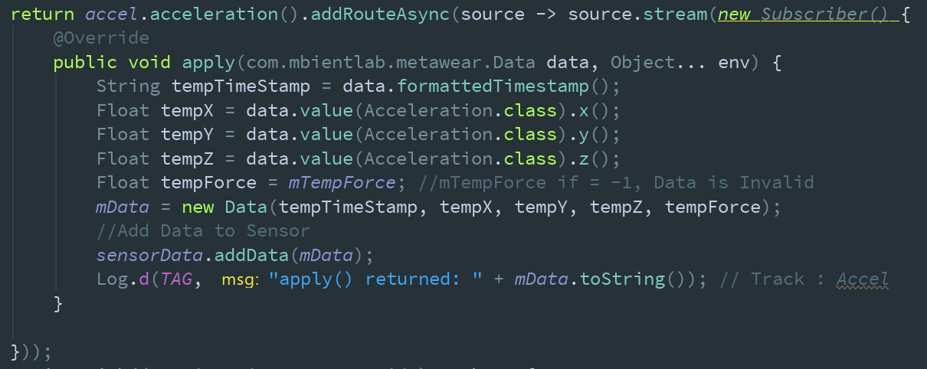
Sensor Data
Notes:
Now, gathering data can be messy. There’s lots of handling behind the scenes which I wont bored you with, but it boils down to this.
Collecting and packaging data in such a way that allows us to processes it effortlessly in the cloud.

Slide 16
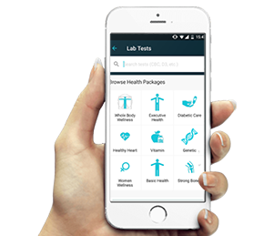
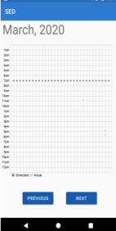
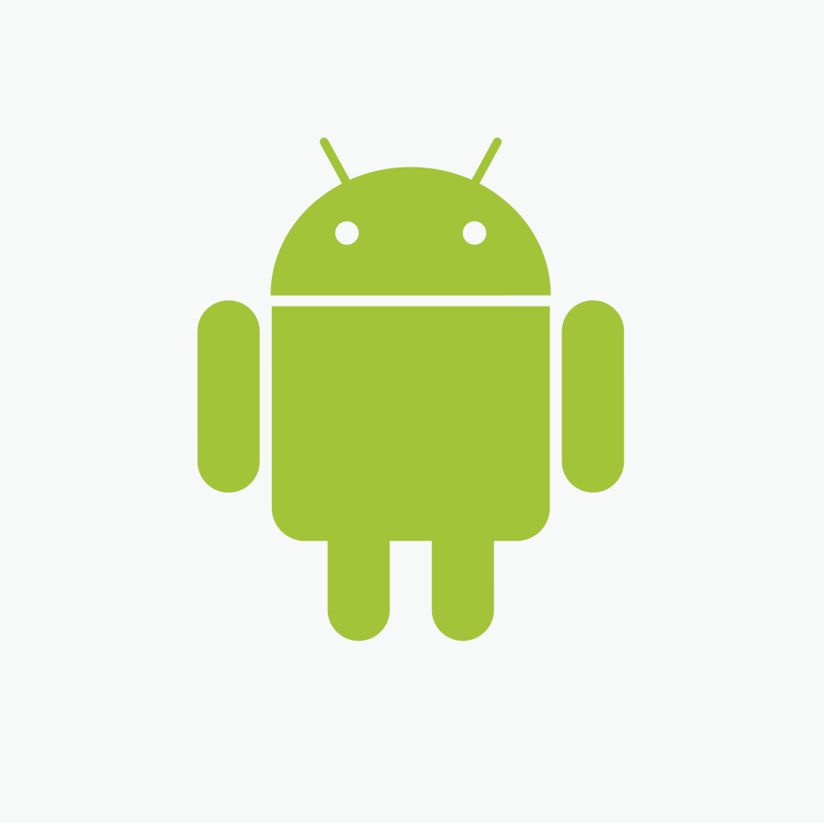

Mobile Application
MetaWear sensor (generate data)
MetaWear API (gather data)
Android Studio (visualize data)
Aaron Alvarez
Notes:
Eventually ….. once all the packaged data has been processed in the cloud, we needed to find a way to display our results. We created an interactive user experience which allowed us to visualized the end results. I will now let Marco explain a little bit more about the user experience.

Slide 17


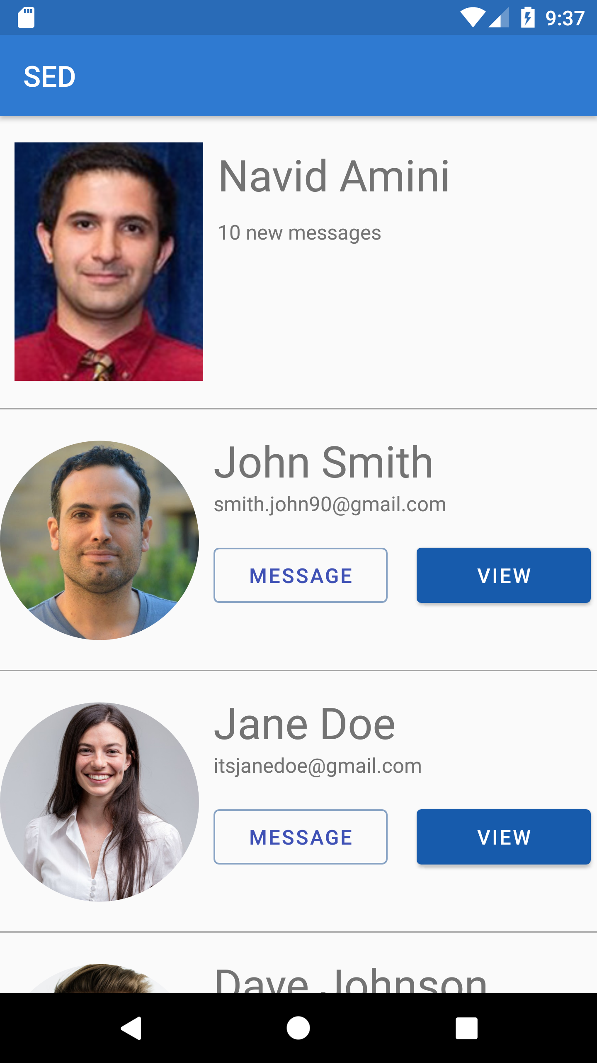
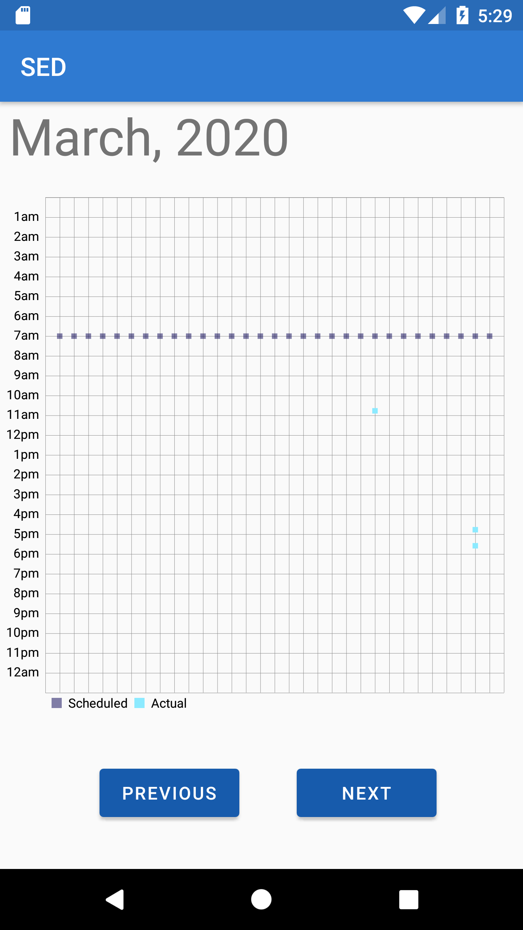
Physician View
Physician profile gives access to their patients
Physicians can view the eye drop adherence of their patients
Able to adjust patient's regimen based on graph
Marco Aguilar
Notes:
So another feature of the Smart Eye Drops application is the Physician View, or rather the Physician's profile. This portion of the app gives the Physician direct access to their list of patients. From here the physician is able to send a message to their patients if they'd like, or click the "View" button to check up on the Patient's progress and view their adherence graph for a particular month.
On the graph you will see that there are two types of data points. One for the scheduled eye drop use, which are displayed using the Grey points on the graph, and the blue data points, which highlight when the Patient actually applied the eye drop. Using this information the Physician will be able to visualize the data clearly and adjust the Patient's eye drop regimen if he or she feels it is necessary.

Slide 18
Cloud Service
Ivan Yu &
Marco Aguilar
Notes:
So I'm briefly going to go over communication flow of the AWS Services and then I'll be handing it off to my colleague Ivan Yu.

Slide 19

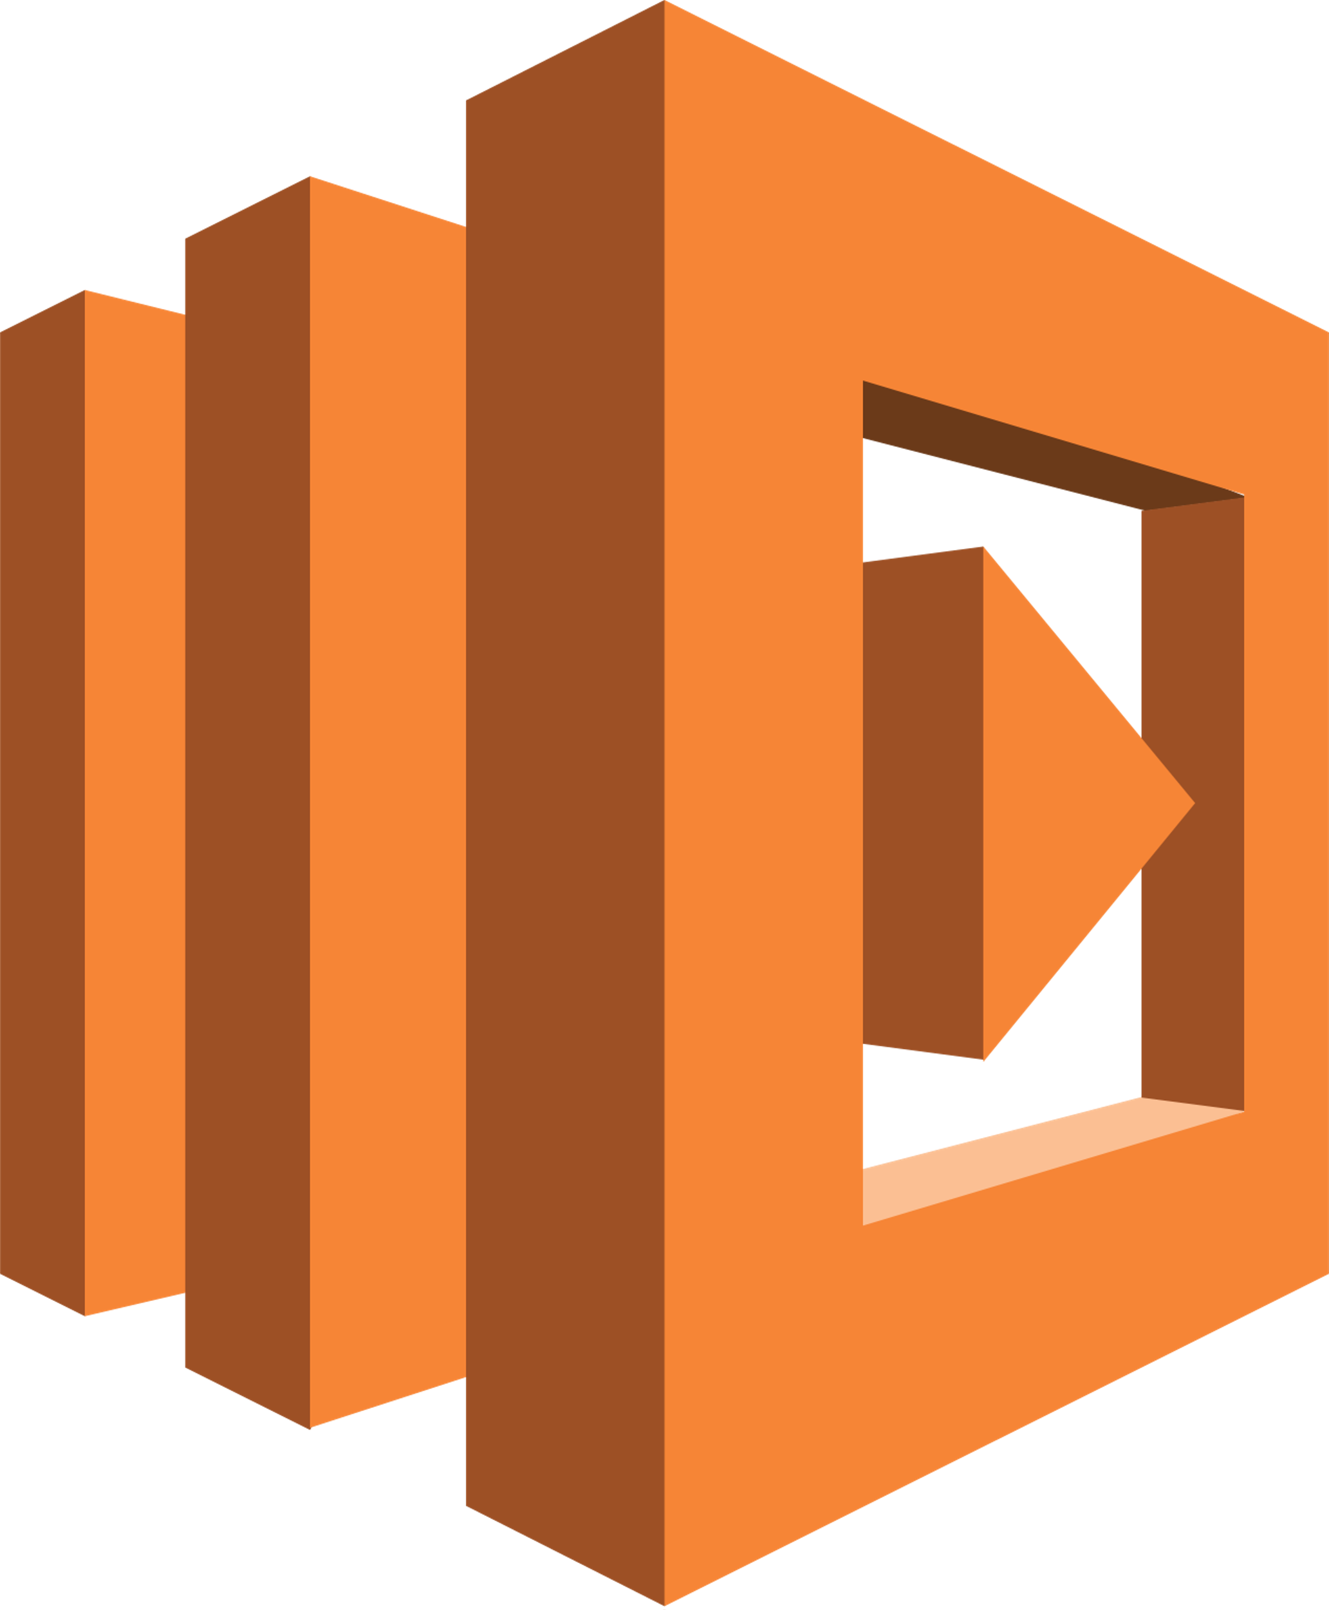
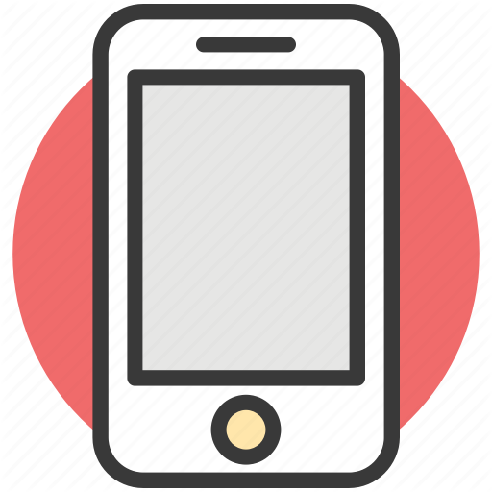
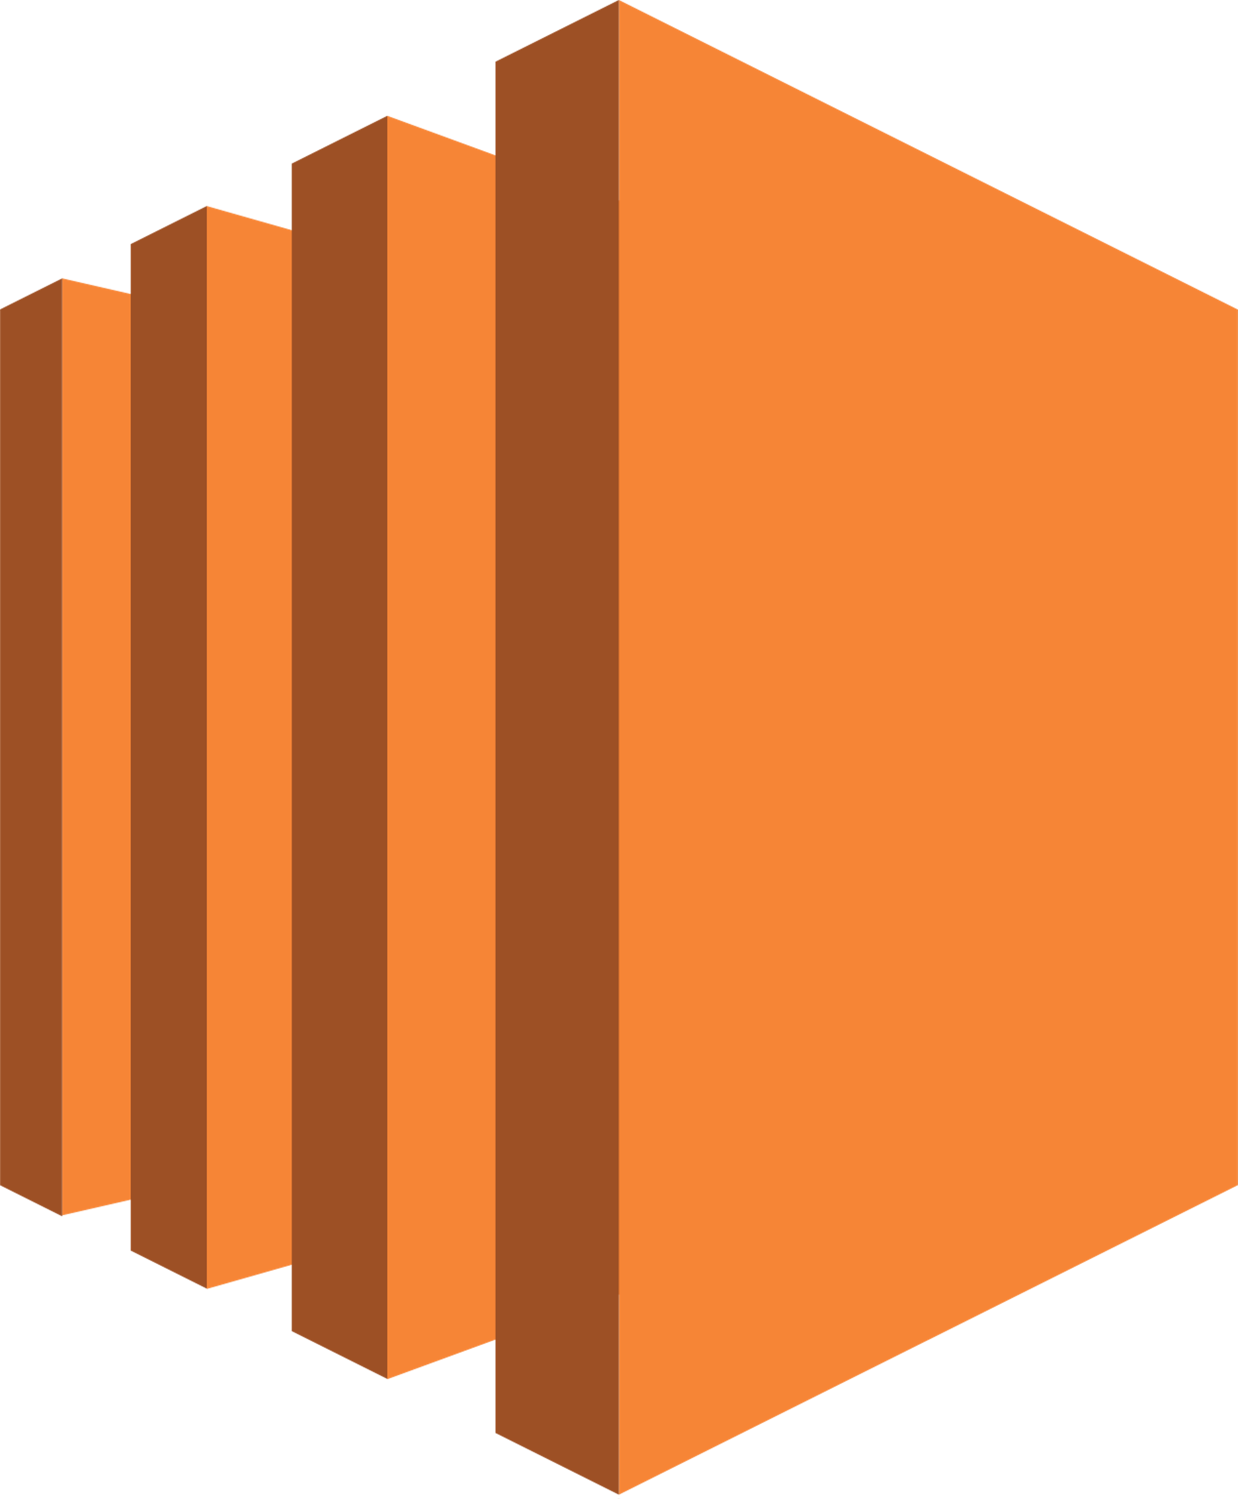


Cloud Communication
API Gateway
Lambda
Smart Eye Drops
Requests are made to API Gateway
Lambda reads/writes to database and returns information to API Gateway
Mobile app sends raw data to EC2 server
Server writes to DynamoDB
EC2
SageMaker
DynamoDB
Marco Aguilar
Notes:
So the Smart Eye Drops app will be sending requests and receiving responses from API Gateway, which acts as the middleman between the user-interface and the backend. API Gateway communicates with AWS Lambda and triggers the function responsible for reading and writing data to the database.
On the bottom portion of the flow diagram we see that the mobile application is also communicating with EC2, which provides the server responsible for applying the machine learning algorithms to our data via SageMaker. Once the data is classified, it is stored away onto the database.
And now Ivan will give a deeper explanation of how we used these AWS services. (End)
One great way to visualize data is to create a mobile application that allows us to visualize the sensors data and its calculations.
We are using Android Studio to create the application as well as the MetaWear API to communicate with the MMC in addition we are using External API’s to cleanly show our data being processed. Creating a mobile application is a easiest way to not only gather data but visualize the data it self.
In conjunction, we are using Smarts Phones Bluetooth connectivity to quickly connect to the sensor itself. This allows to monitor the Sensor, without any cables.

Slide 20
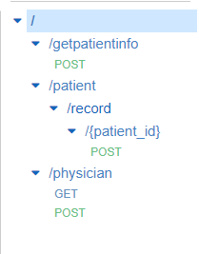
API Gateway
API Gateway is the front door of our application.
API Gateway allows us to create our own API.
Ivan Yu
Notes:
What is api gateway?
Api gateway is like the front door of our application.
Its like walking into a home and leting us talk to each members of that home.
API gateway allows us to create our own api. In our case we are making a REST API which is an api that
is http based. This allows us to make GET, POST, PUT and DELETE to our with our lambda applications.

Slide 21
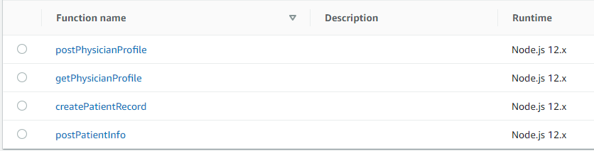
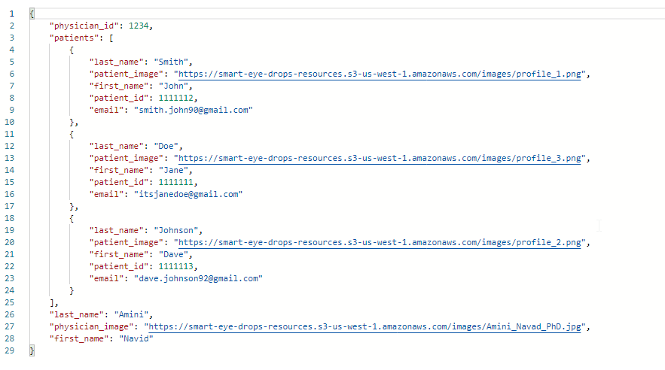
Lambda
AWS Lambda is a serverless computing platform.
Allows for the creation of any type of application and running it without any servers.
Ivan Yu
Notes:
Thats brings us to Lambda...
What exactly is Lambda?
AWS lambda is a serverless computing platform. that means that it allows us to create virtually
any type of application and running it without any servers.
We are currently using lambda to communicate with our database. This includes applications that allow us to write, read, delete from our dynamodb.

Slide 22
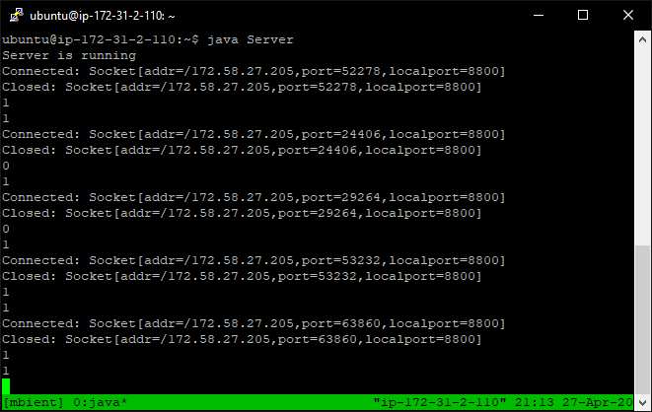
EC2
EC2 is a web service that provides secure, resizable compute capacity.
We are currently using EC2 to process raw data and adding it to the database.
Ivan Yu
Notes:
We are also currently using EC2. EC2 is a web service that provides secure, resizable compute capacity. It is essentially a
virtual machine. We are currently using EC2 to process raw data, invoking sagemaker to make a prediction and adding it to our dynamoDB

Slide 23
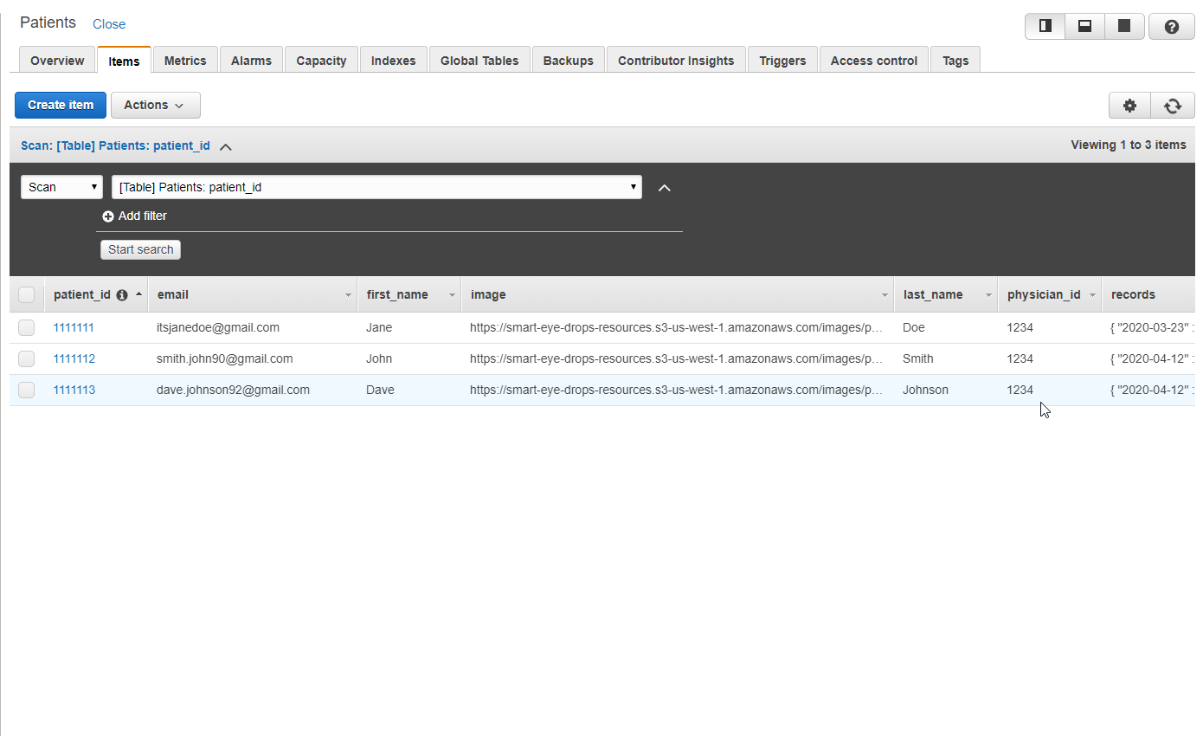
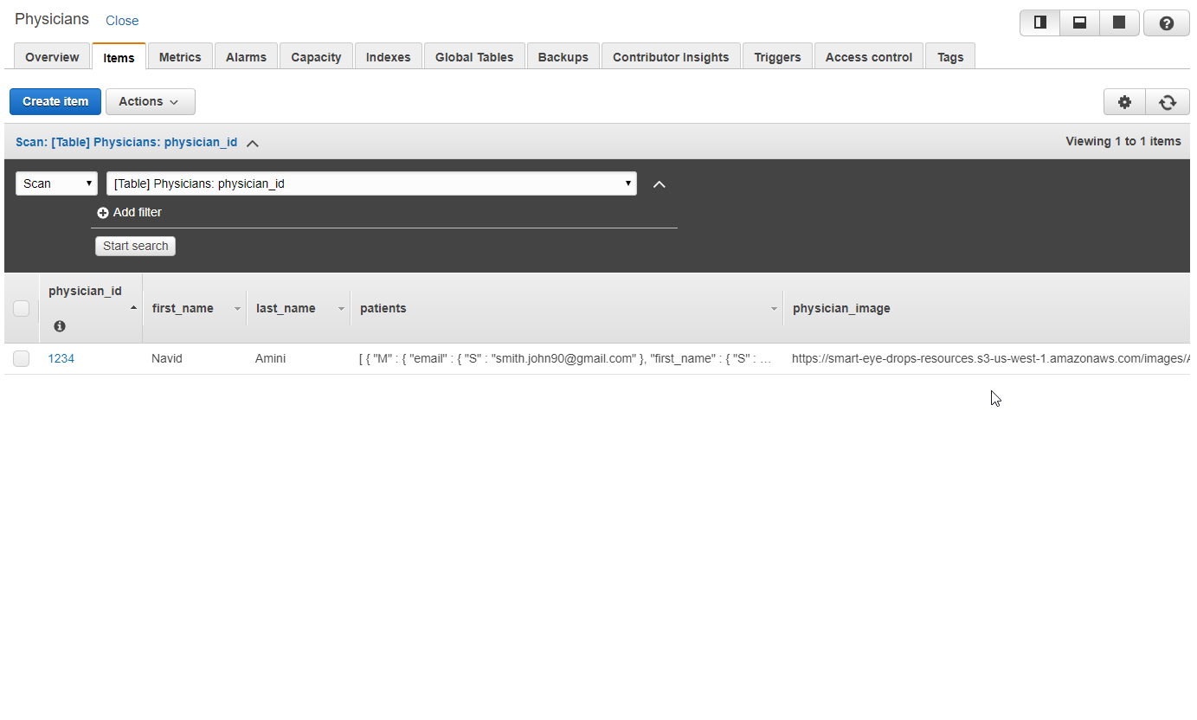
DynamoDB
DynamoDB is a database service.
Supports key-value data structure.
Ivan Yu
Notes:
You probably heard us say DynamoDB multiple times already. so what exactly is DynamoDB?
DynamoDB is amazons database service. It supports key-value data structures which is exactly how we're using it.
For example, each physcian has a ID that we can look up and pull out his list of patients. Another one would be that each patient has an ID that we
can look up to pull up each adherence record this patient has.

Slide 24
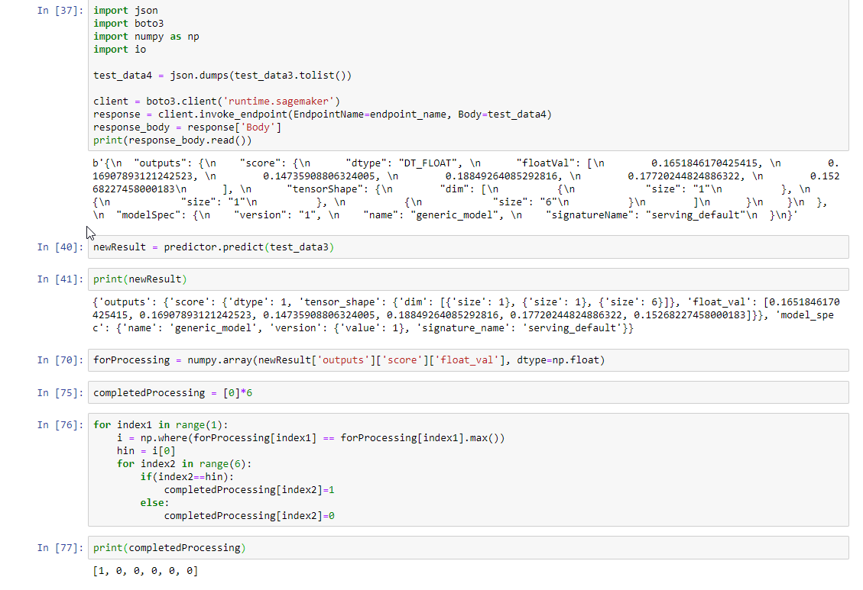
Sagemaker
Sagemaker is an AWS service that specifically targets machine learning and data science.
We are using Sagemaker to host our models and make predictions on adherence.
Ivan Yu
Notes:
Finally, we used AWS Sagemaker for all our machine learning needs. AWS sagemaker is an aws service that specifically targets
machine learning and data science. We are using Sagemaker to host all our models and make predictions on adherence.

Slide 25
Machine Learning
Jonathan Nunez

Slide 26
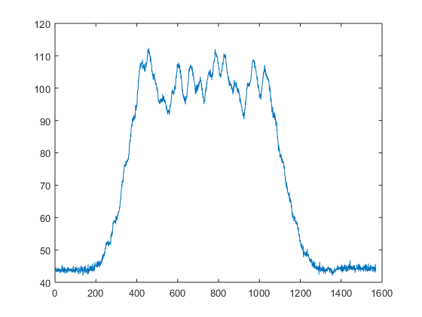
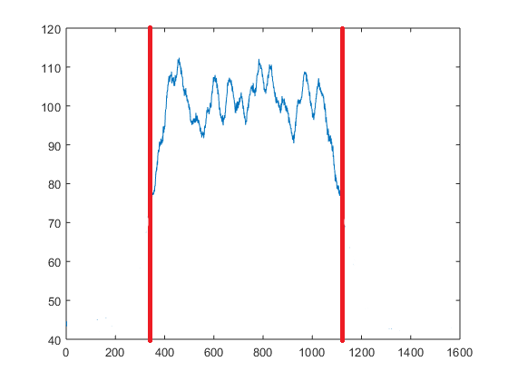
Thresholding
Simple and easy to implement.
Not very accurate.
The data needs to be gathered in a specific way.
Jonathan Nunez
Jonathan Nunez
Notes:
Before we started doing machine learning we did simple thresholding on the data sent to the server on EC2.
To determine if the eye drop was used the accelerometer sensor had to detect a change in one of its axis from positive to negative or negative to positive, which will determine that the eye drop bottle has been flip upside down. The force sensor also has to be squeezed past a certain amount of force for a specific amount of time.
If these two happened then it will determine that the eye drop bottle was used.
It was easy to implement these, but it was not accurate, and sometimes it would not be able to determine if the eye drop bottle was used due to different methods of applying.

Slide 27

Long short-term Memory
Learns from long-term dependencies .
Avoids certain dependency problems
Holds onto information for a longer period
Jonathan Nunez
Jonathan Nunez
Notes:
The machine learning algorithm we used is long short-term memory; it is a type of reccurent neural network.
This algorithom learns from Long-term dependencies, with long-term dependencies we can get a desired output that depends on the inputs presented in the far past. It avoids certain dependency problems by holding onto information for longer periods of time.
Accuracy <- paper
Properties <- paper
Fall detection paper as template for paper in machine learning

Slide 28
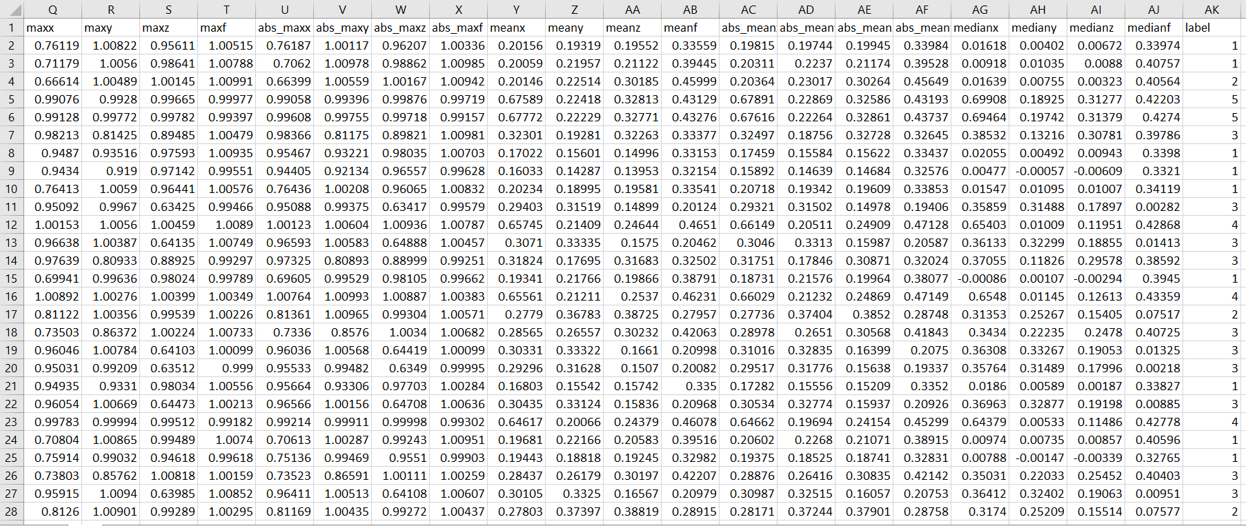
Data
36 Features.
6 categories.
Time series of data.
Jonathan Nunez
Jonathan Nunez
Notes:
The data is collected in intervals of 20 seconds gathering a total of 491 data sets for each application; which is turned into one data set of features.
We get features, such as average, minimum, and kurtosis from each axis and force sensor, totaling in 36 features.
When we gathered data, we labeled each data set according to they type of application; one drop, two drops, no drops, walking around, standing still, and accidiental drop.
Or data is then trained in the machine learning model on sagemaker where it will be able to make predictions on new incoming data.
If it was predicted to be either one drop or two drops then dynamoDB will be updated, if not then the data will be discarded.

Slide 29
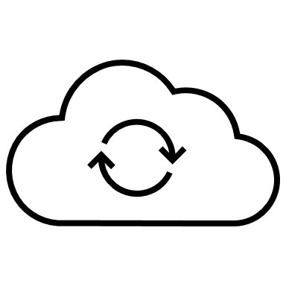
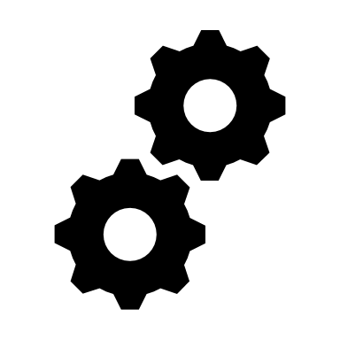
Accomplishments
Successfully connect different sensors
Retrieve data from sensors and display in real time
Connect to AWS to collect data
Functional Prototype
Jonathan Nunez
Notes:
5 second end to end <- add to paper
Possible problems that might be encountered
One page in the paper discussing future plans and ^^

Slide 30

Challenges
Learning how to use more than one service provided by AWS.
Working with hardware, despite being software developers
Working with libraries that don't always have the best documentation
Notes:
These are the challenges we faces when working on this project.
Learning how to interconnect all the services we used on aws.
Working with hardware eventhough we are software developers.
Working with librarys that did not have that good documentation.

Slide 31
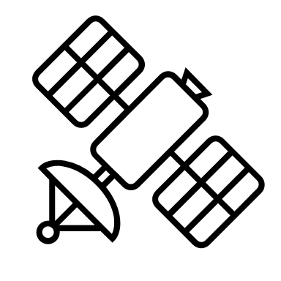

Summary
Connect to AWS and it's services to process data
Implement machine learning
Build a fully functioning prototype
Collect data from sensors in real time
Jonathan Nunez
Notes:
To summarize what we have accomplished:
we were abe to collect live data from the sensors.
Build a functional prototype.
Steam and collect data from aws to disply on our mobile app.
Implement our machine learning algorithing to sagemaker.

Slide 32
Demo

Slide 33

Video Demo
Notes:
Video of squeezing the bottle

Slide 34
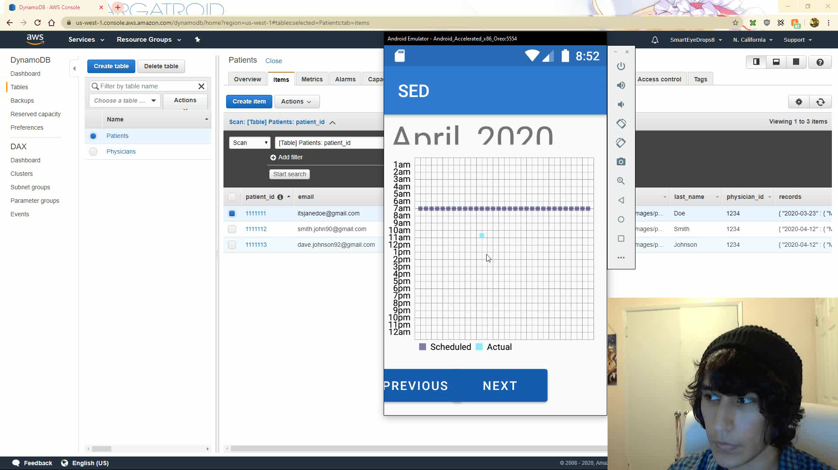

Slide 35
Questions?

Slide 36
References
Ajerla, D., Mahfuz, S., & Zulkernine, F. (2019). A Real-Time Patient Monitoring Framework for Fall Detection. Wireless Communications and Mobile Computing, 2019, 9507938. https://doi.org/10.1155/2019/9507938
Eaton, A. M., Gordon, G. M., Konowal, A., Allen, A., Allen, M., Sgarlata, A., … Avery, R. L. (2015). A novel eye drop application monitor to assess patient compliance with a prescribed regimen: A pilot study. Eye (Basingstoke), 29(10), 1383–1391. https://doi.org/10.1038/eye.2015.155
Gatwood, J. D., Johnson, J., & Jerkins, B. (2017). Comparisons of Self-reported Glaucoma Medication Adherence with a New Wireless Device: A Pilot Study. Journal of Glaucoma. https://doi.org/10.1097/IJG.0000000000000777
Adherence, I., & Eye, O. F. (2016). I (10), (12).
Force, A. (2018). That Tartani a Man a Na Na Na Na Na Ta Naman Maalim, 1.
States, U. (2014). (12) Patent Application Publication (10) Pub. No.: US 2014/0228783 A1, 1(19).
Nishimura, K., Tabuchi, H., Nakakura, S., Nakatani, Y., Yorihiro, A., Hasegawa, S., … Kiuchi, Y. (2019). Evaluation of automatic monitoring of instillation adherence using eye dropper bottle sensor and deep learning in patients with glaucoma. Translational Vision Science and Technology, 8(3). https://doi.org/10.1167/tvst.8.3.55
Us, M. A., & Jere, R. (2016). ( 2 ) Patent Application Publication ( 10 ) Pub . No .: US 2016 / 0089852 A1 Patent Application Publication, 1(19).
Morse, A. R. (2015). Improving Medication Adherence to Reduce Vision Loss in Patients with Glaucoma: Low Hanging Fruit? Ophthalmology, 122(7), 1280–1282. https://doi.org/10.1016/j.ophtha.2015.04.019
Ma, J., Ovalle, A., & Woodbridge, D. M. K. (2018). Medhere: A Smartwatch-based Medication Adherence Monitoring System using Machine Learning and Distributed Computing. Proceedings of the Annual International Conference of the IEEE Engineering in Medicine and Biology Society, EMBS, 2018-July, 4945–4948. https://doi.org/10.1109/EMBC.2018.8513169
Robin, A. L., & Muir, K. W. (2019). Medication adherence in patients with ocular hypertension or glaucoma. Expert Review of Ophthalmology, 14(4–5), 199–210. https://doi.org/10.1080/17469899.2019.1635456
Ma, J., Ovalle, A., & Woodbridge, D. (2016). Medication Adherence Monitoring using Machine Learning, 16(4), 4986.
Hermann, M. M., & Diestelhorst, M. (2006). Microprocessor controlled compliance monitor for eye drop medication. British Journal of Ophthalmology, 90(7), 830–832. https://doi.org/10.1136/bjo.2005.088526
Kashiwagi, K. (2019). Wide Variation of Squeezing Force and Dispensing Time Interval among Eyedropper Bottles. Journal of Ophthalmology, 2019. https://doi.org/10.1155/2019/7250563

Slide 37
Additional Information

Slide 38
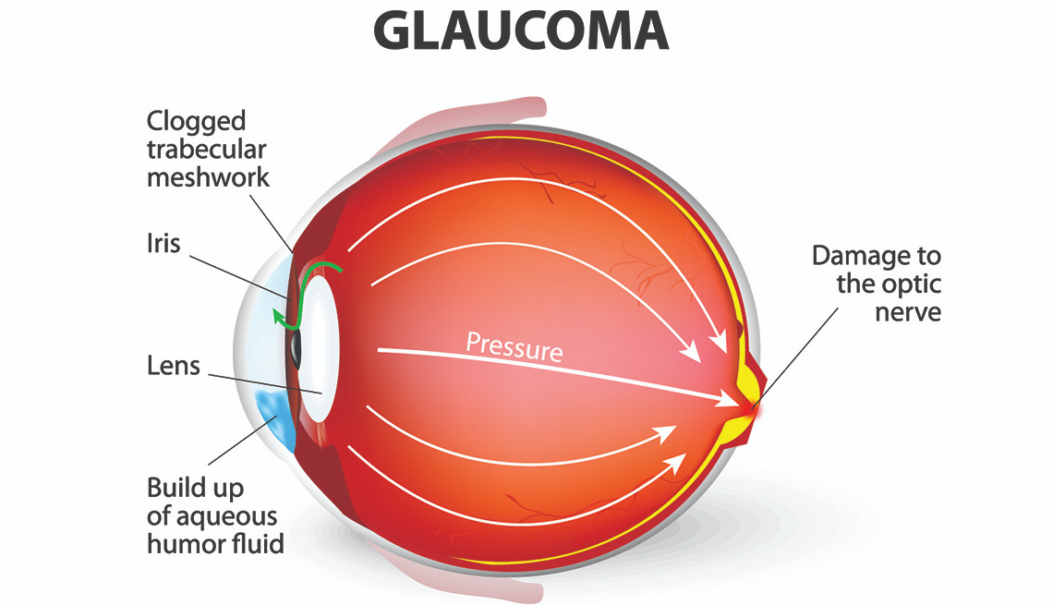
Glaucoma
Glaucoma is a group of eye diseases that can lead to blindness by damaging the optic nerve. The eye continuously produces a fluid, called the aqueous, that must drain from the eye to maintain healthy eye pressure.
Glaucoma results in a loss of peripheral or side vision initially, affecting your ability to move about safely.
Can damage your central vision as well.
Glaucoma can affect reading; reducing the number of words you can see at one time.

Slide 39
Glaucoma Adherence
Adherence to topical glaucoma medication regimens comprises a spectrum of patient behaviors:
Obtaining the medication
Using the medication every day
Appropriately timing the doses
Successfully instilling the medication into the eye
A patient is nonadherent if:
Not filling a prescription
Missing a dose
Too long between doses
Anything that interferes with the medication reaching the eye.

Slide 40
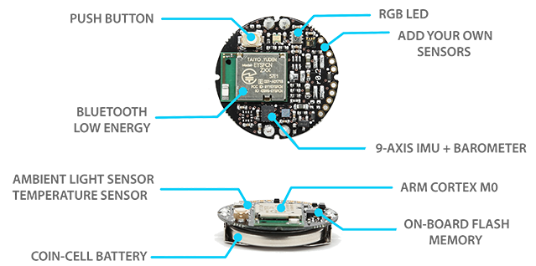
MBIentLab MMC
Dimensions:
25mm diameter x 4mm in case
Weight: 0.2oz
Battery: 200mAH coin-cell
Splash resistant: IP40 plastic case

Slide 41
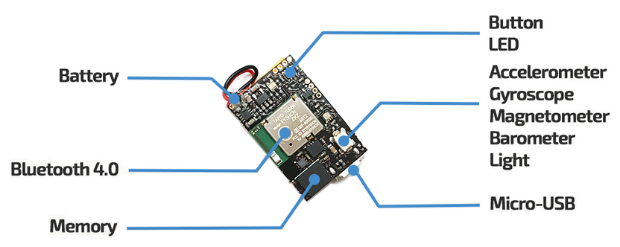
MBIentLab MMR
Dimensions:
27mm x 27mm x 4mm in case
Weight: 0.2oz
Battery: 100mAH micro-USB rechargeable
Splash resistant: IP40 plastic case

Slide 42
FSR model 406
4cm x 4cm active area
Solder tabs
Force accuracy ranges from 5% to 25%
Sensing range from 0.2N to 20N
Notes:
https://www.amazon.com/SENSING-RESISTOR-SQUARE-1oz-22LBS-SPACING/dp/B00B887DBC/ref=sr_1_fkmr1_1?keywords=FlexiForce+A401+Sensor&qid=1569961986&sr=8-1-fkmr1 link to amazon purchase
It is from Interlink Electronics.
Pololu website
https://www.pololu.com/product/1645
Interlinks Electronics website:
https://buyinterlinkelectronics.com/collections/new-standard-force-sensors/products/fsr-model-406?variant=31639756112009

